Slide 2
DF TICKETING SYSTEM Test Server http://ec2-13-212-83-175.ap-southeast-1.compute.amazonaws.com:81/

Slide 3
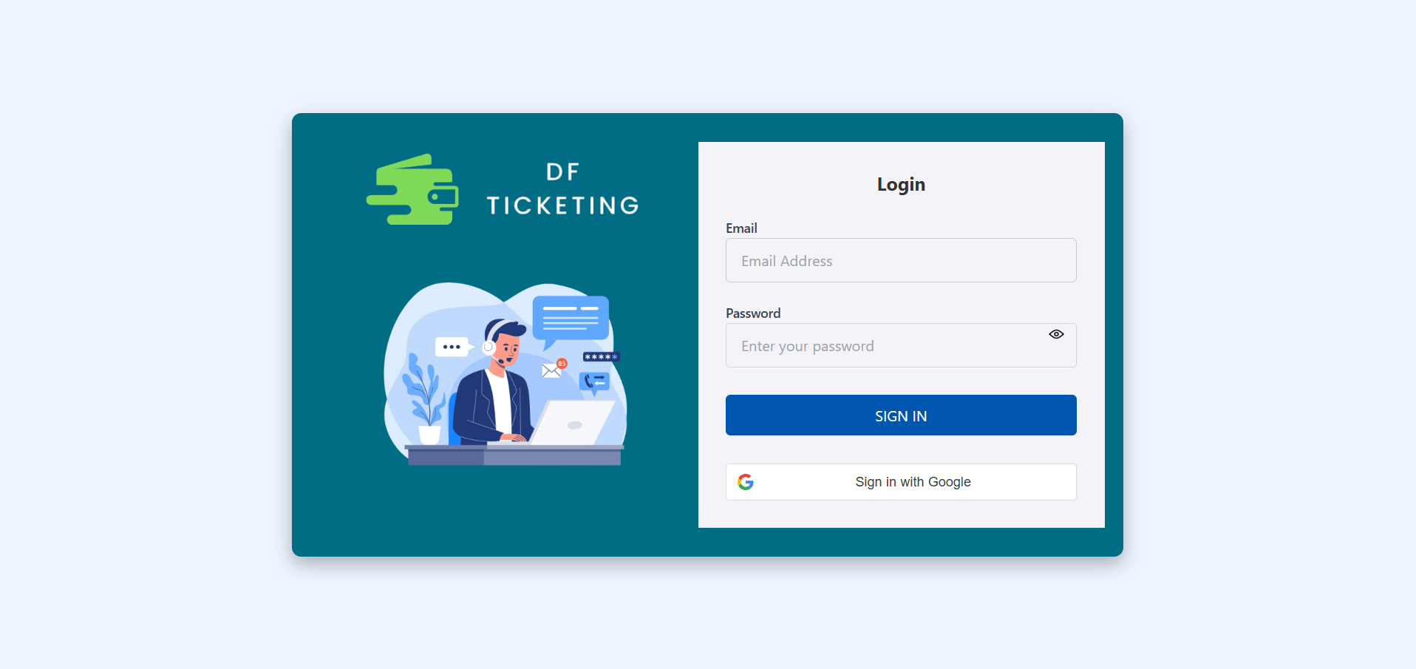
Login Page
You can log in using your DF email and the auto-generated password sent to your registered email address.
OR
You can log in using the Google option with your registered DF email address.

Slide 4
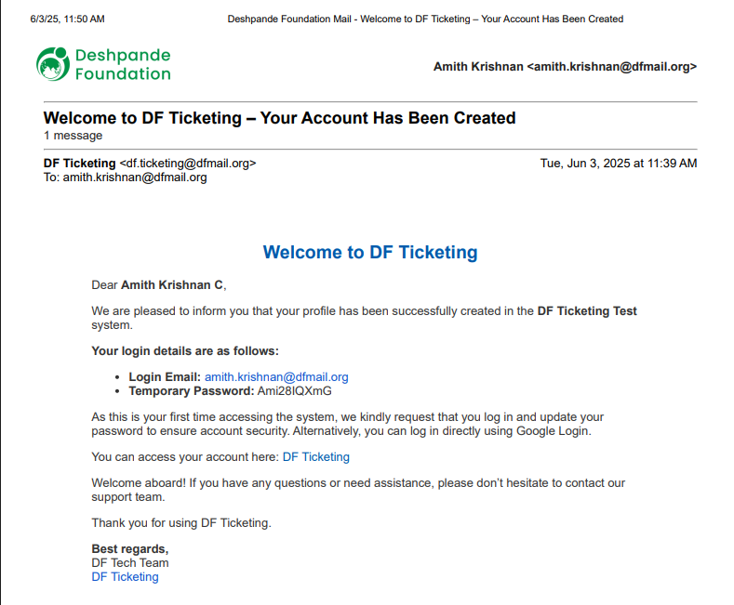
Email

Slide 5
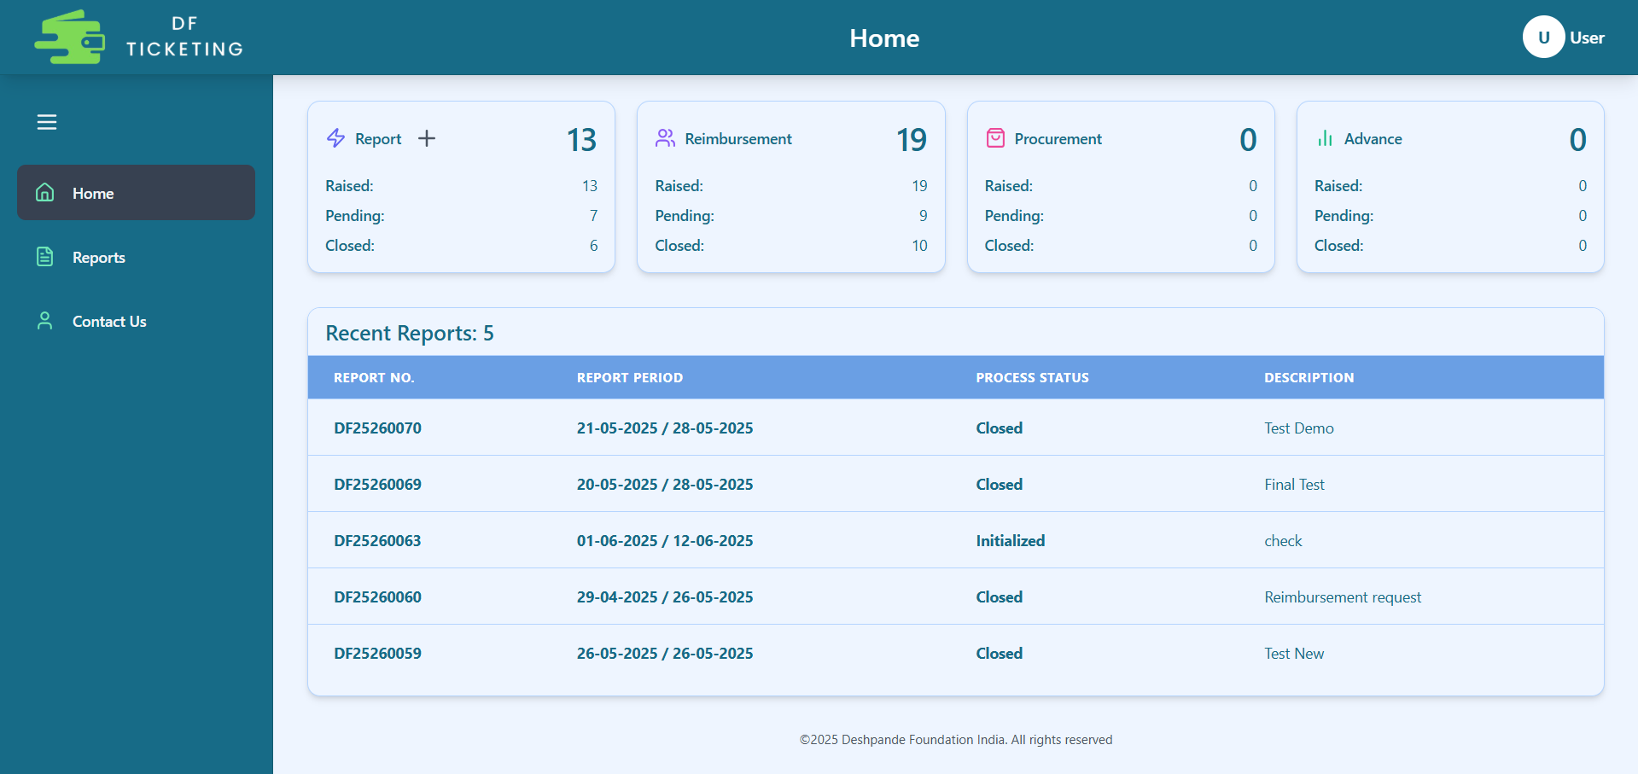
Home Page
This is the Profile section
Click the plus (+) button to create a new report.
At the top, you can view the number and status of Reports you have opened, as well as those related to Reimbursement, Procurement, and Advance.
In this section, you can view the Report Details, including the Report Number, Report Period, Process Status, and Report Description.

Slide 6
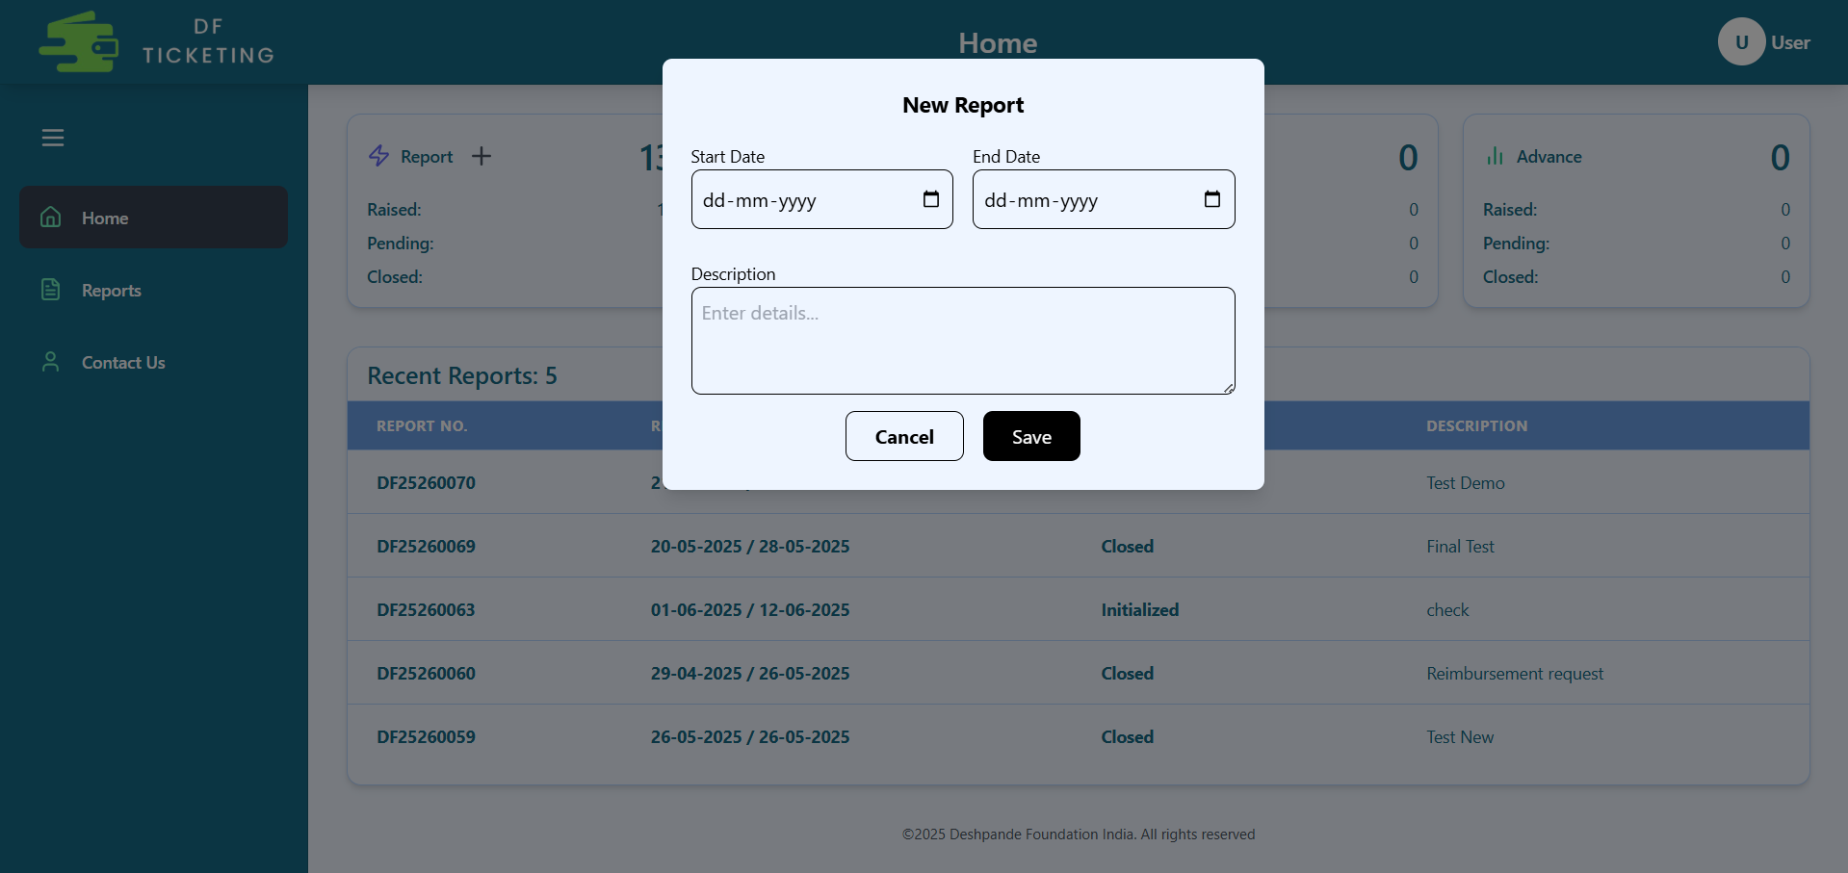
Create NEW Report
These dates define the time range for the tickets you intend to create.
When you click the plus (+) button, this pop-up will appear. You need to fill in all the details, including the Report Start Date, Report End Date, and a short description of the report.
Click on 'Save' to create the report.

Slide 7
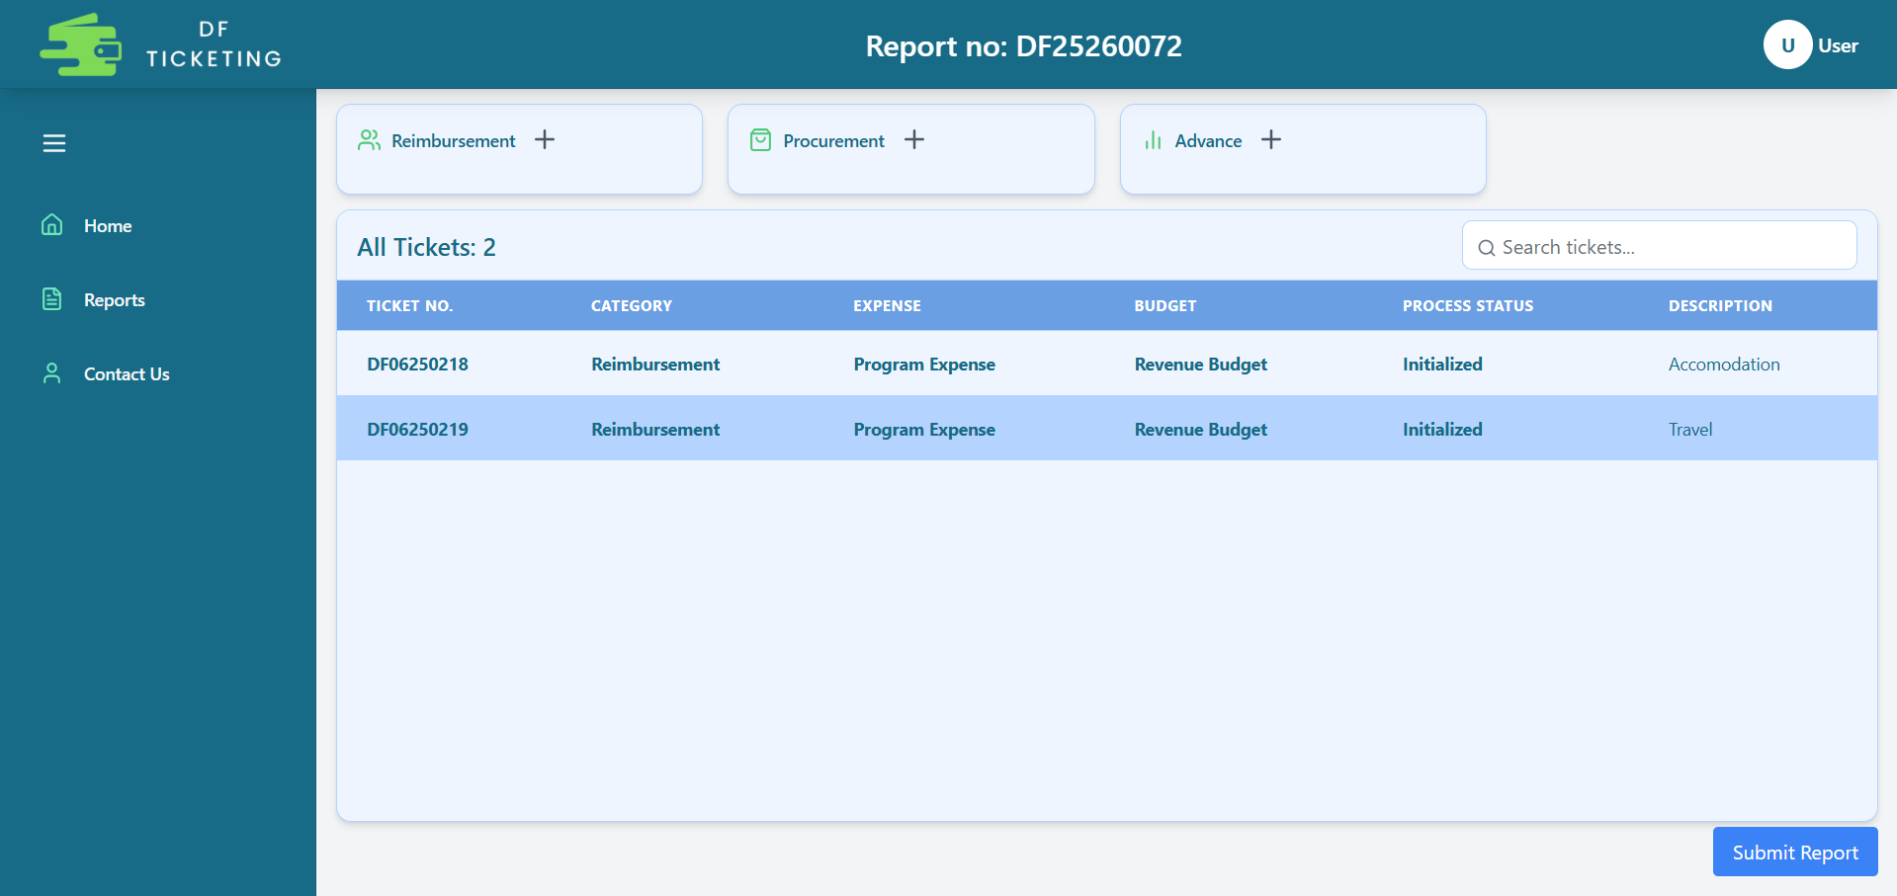
Tickets Section
This is the Report ID
From here, you can create different types of tickets such as Reimbursement, Procurement, and Advance.
Here, you can view the tickets you have created.
This is Ticket ID
Click 'Submit' to submit your report along with all your tickets.

Slide 8
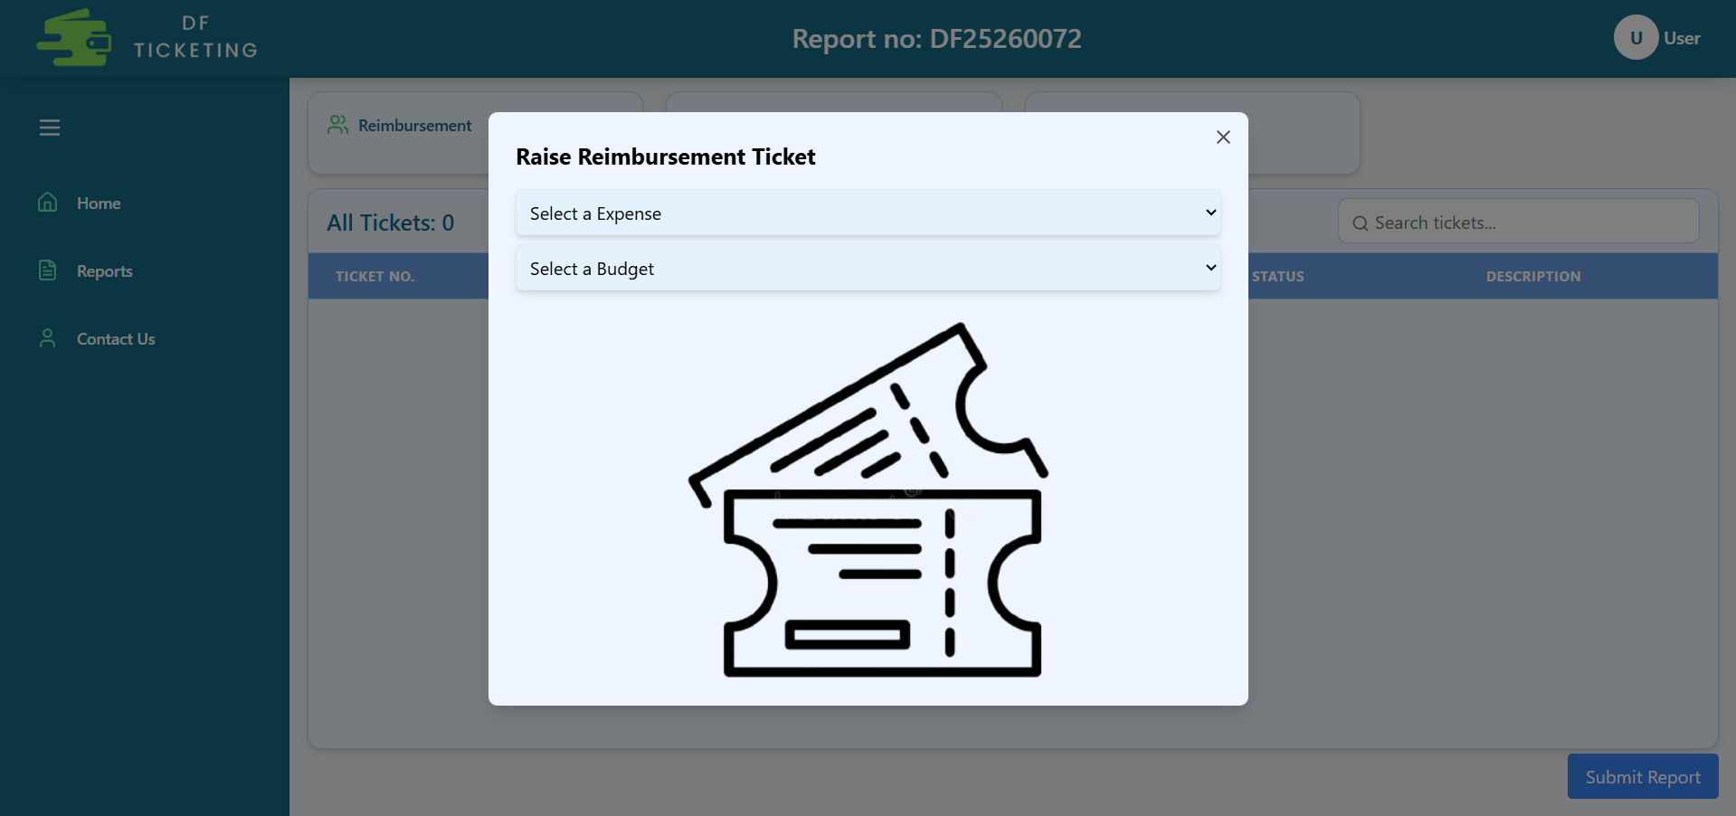
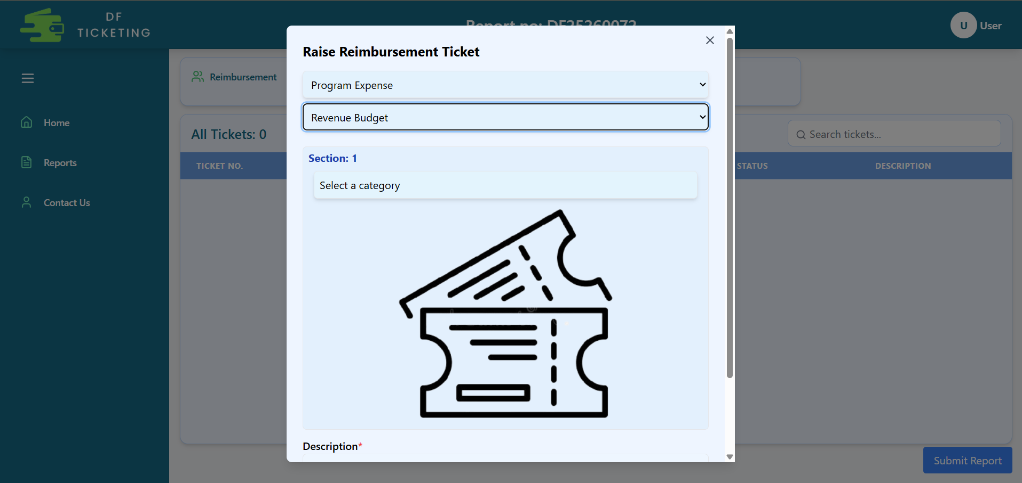
Create Reimbursement Ticket
When you click the plus (+) button next to Reimbursement, a pop-up will open where you need to select the Expense Type and Budget Type.
As you make your selection, the section below will open, allowing you to choose the reimbursement category—such as Food, Travel, Accommodation, etc.

Slide 9
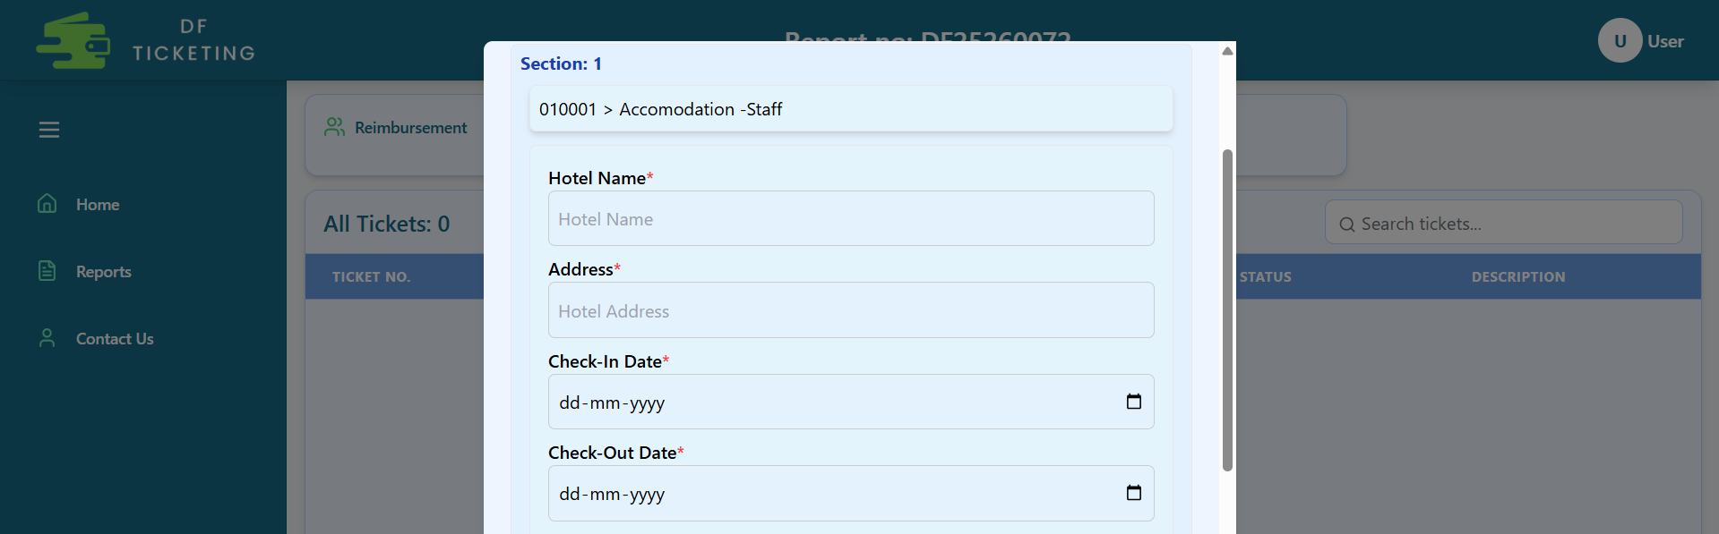
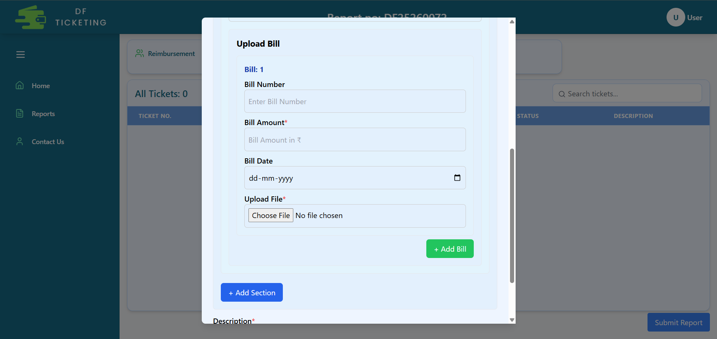
Accommodation Reimbursement
Now, if you select Accommodation, this section will open where you need to fill in all the details marked with a red asterisk (*).
The section below is for attaching bills related to that expense.

Slide 10
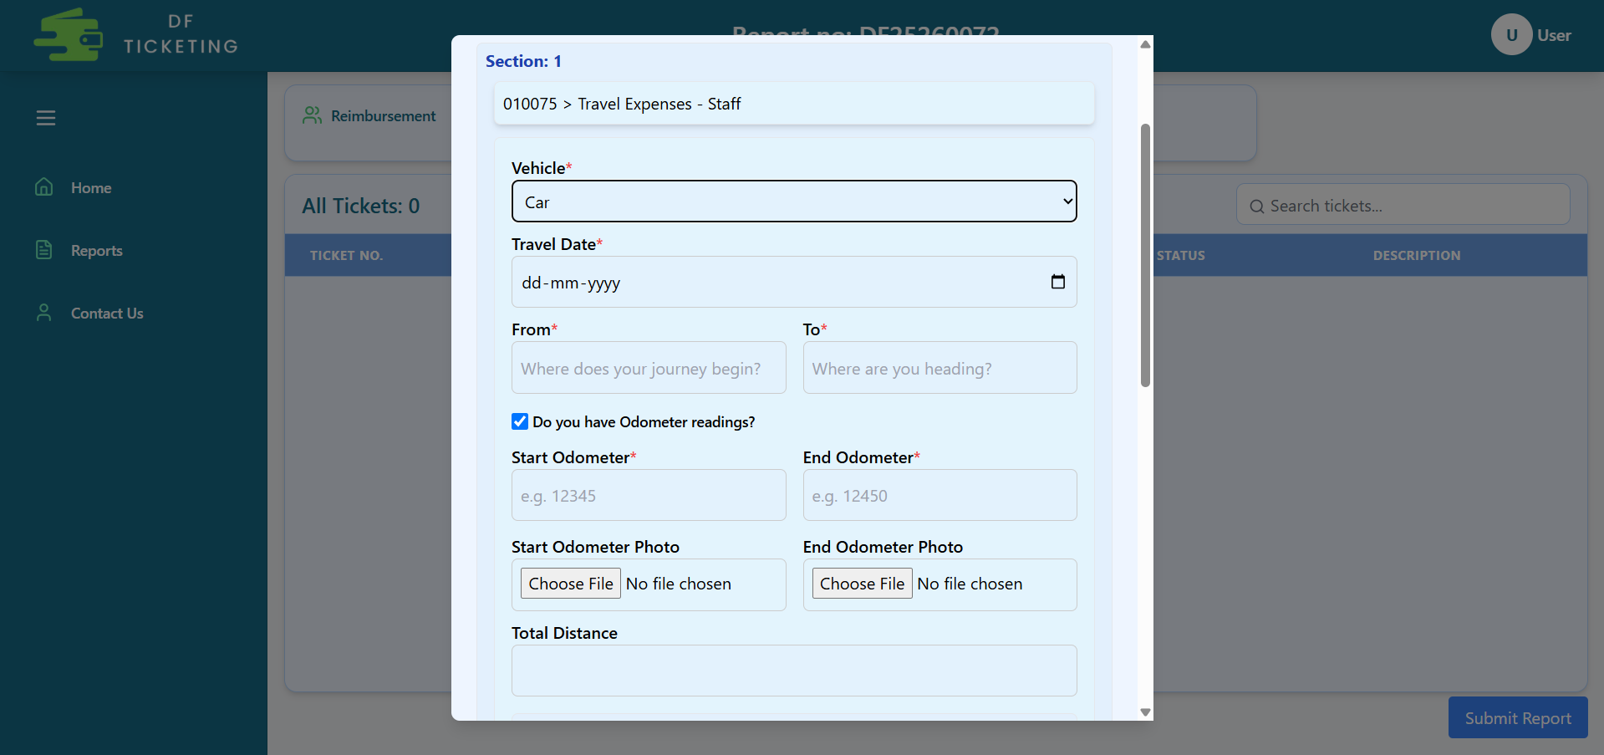
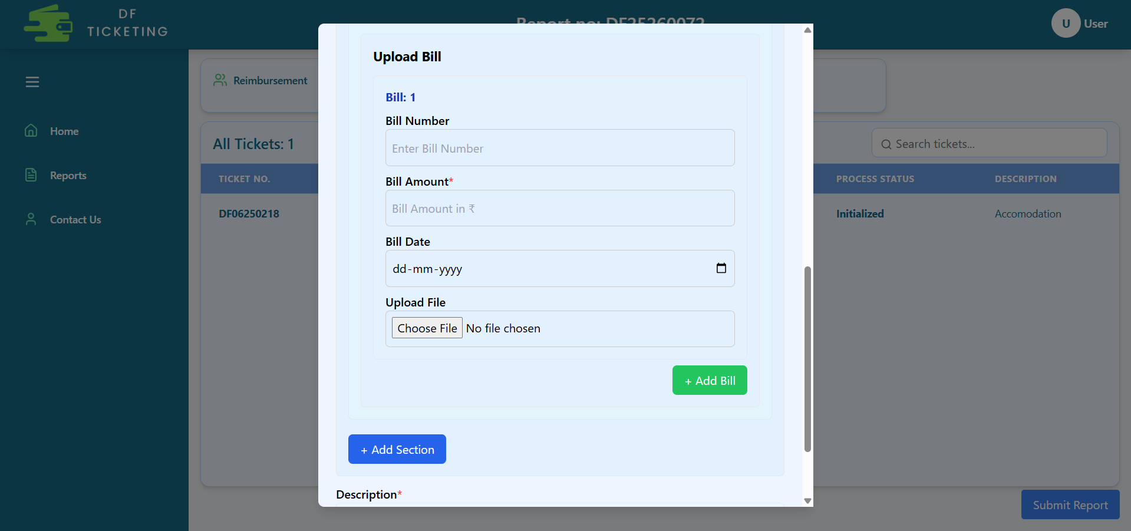
Travel Reimbursement
Now, if you select Travel, this section will open where you need to fill in all the details marked with a red asterisk (*).
The section below is for attaching bills related to that expense.

Slide 11
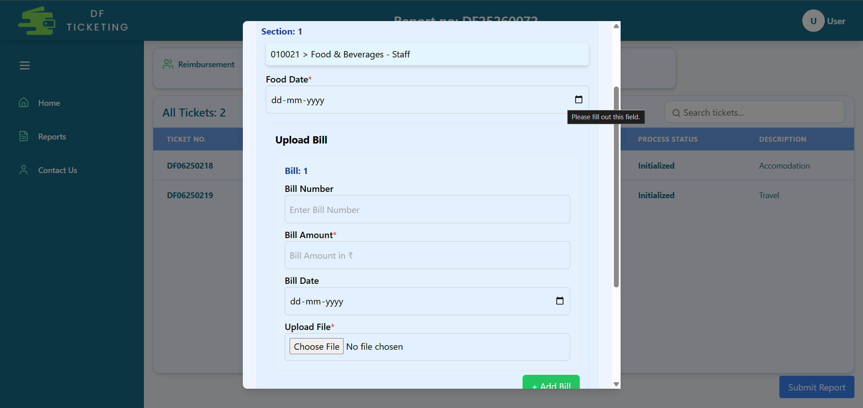
Food Reimbursement
Now, if you select Food, this section will open where you need to fill in all the details marked with a red asterisk (*).
The section below is for attaching bills related to that expense.

Slide 12
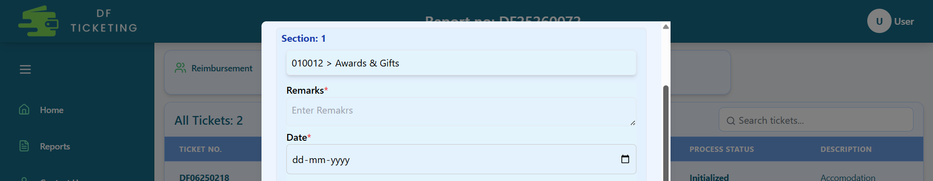
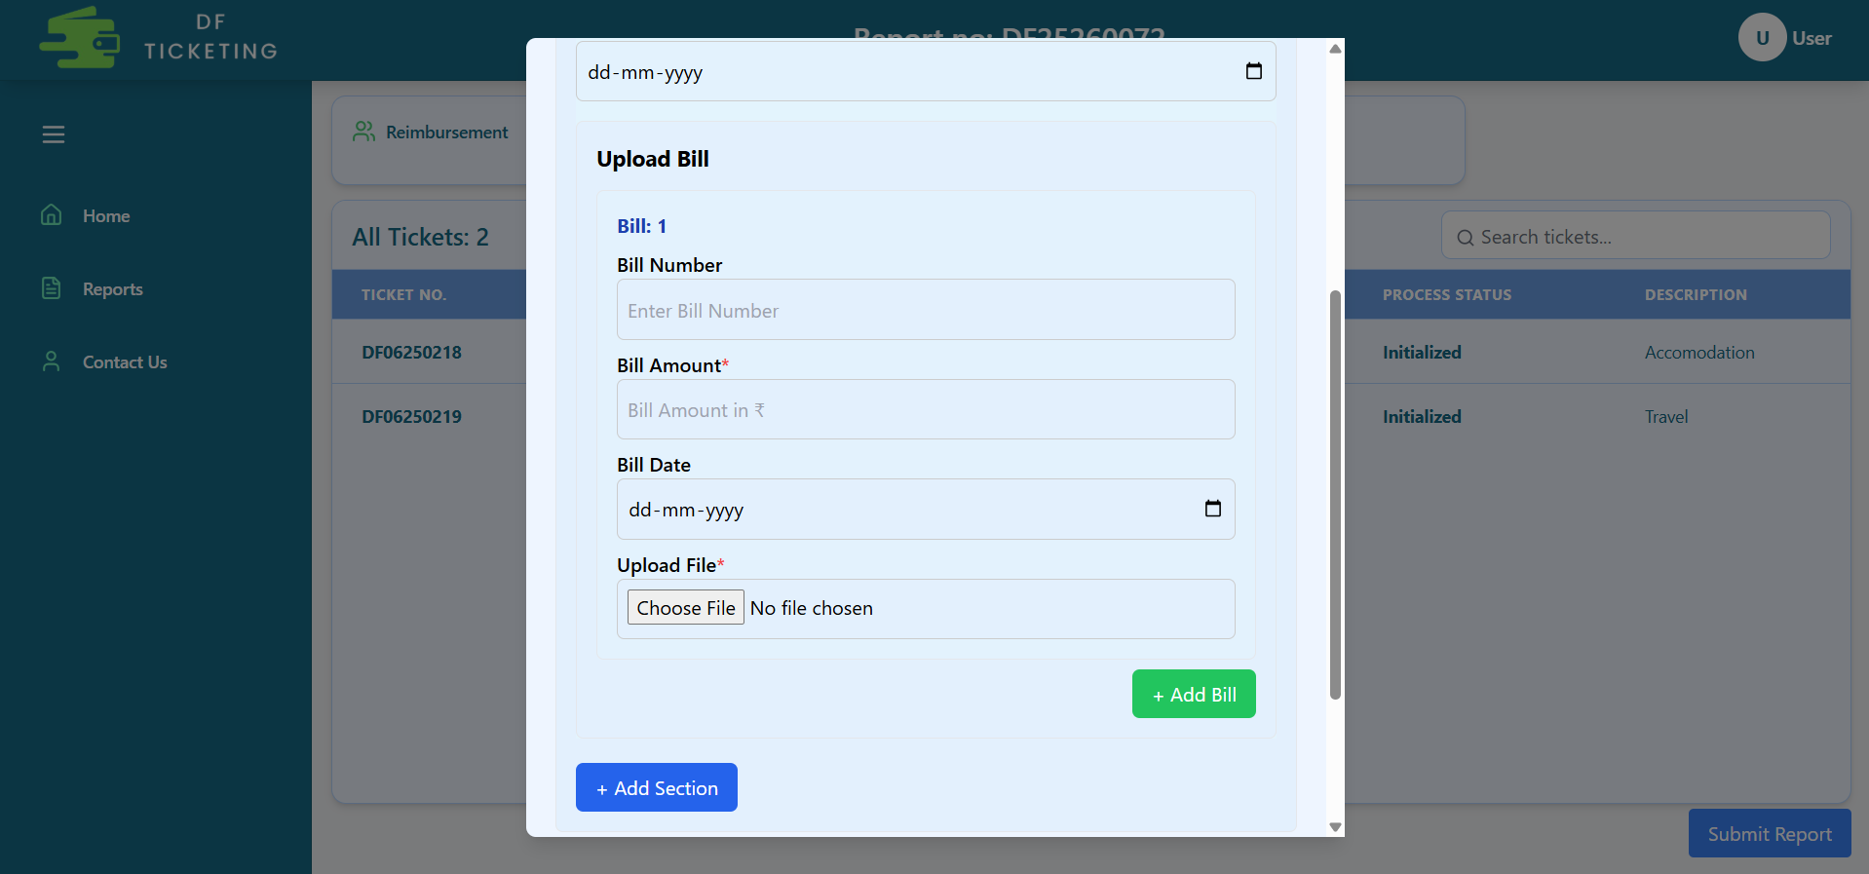
Any Other Reimbursement
Now, if you select Other Reimbursement, this section will open where you need to fill in all the details marked with a red asterisk (*).
The section below is for attaching bills related to that expense.

Slide 13
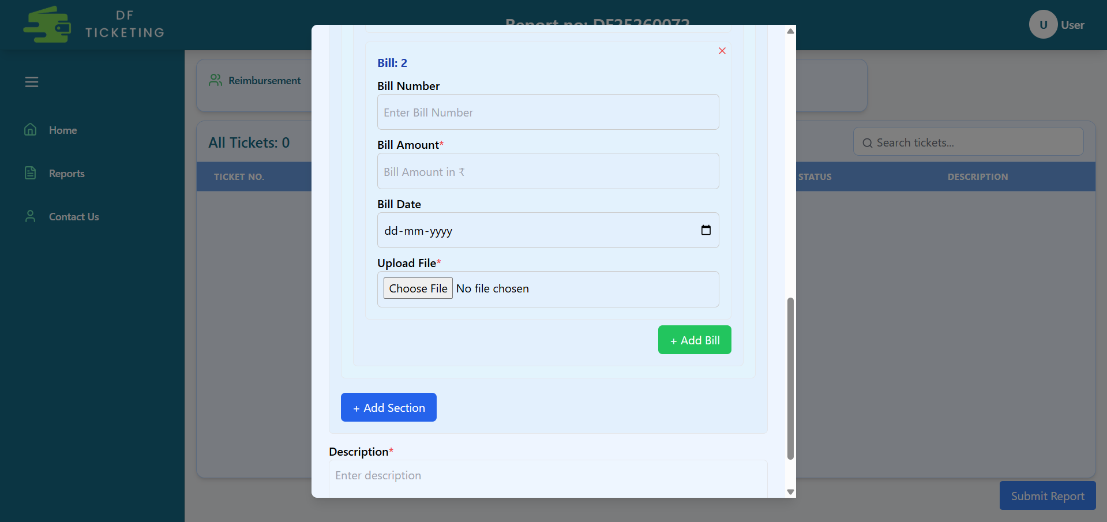
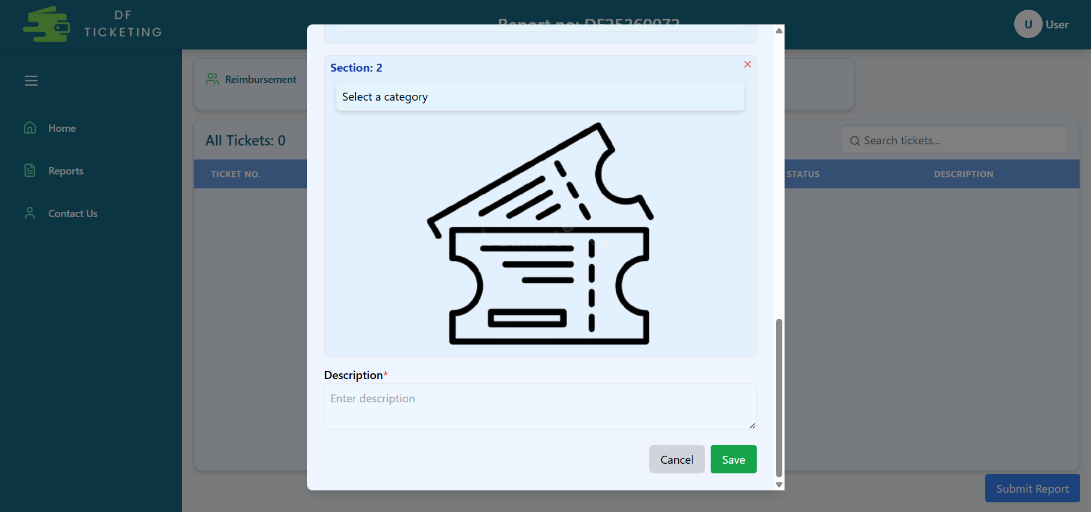
Create Ticket Additional Details
When you click 'Add Bill,' a new bill section will open.
When you select 'Add Section,' a new section opens for you to add a new expense category.
Here, you need to add a brief description.
Click the 'Save' button to create the ticket.

Slide 14
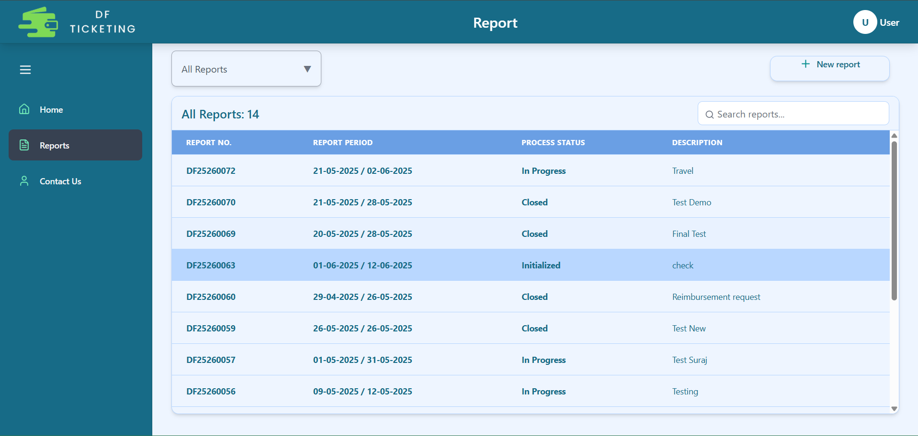
Reports Page

Slide 15
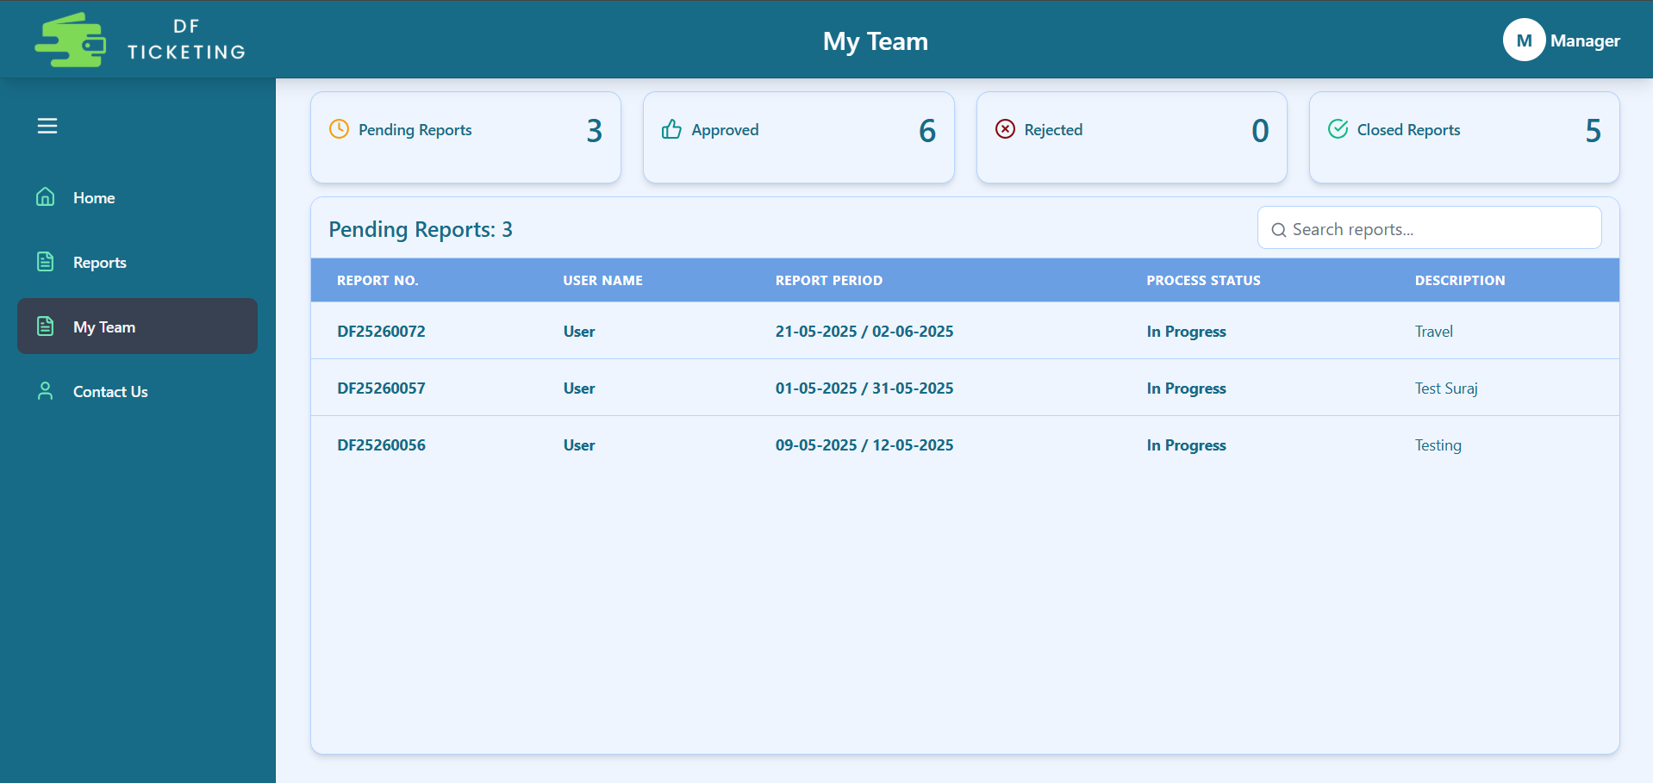
Manager Page
Count of Reports status
List of reports raised by Manager’s Team
Managers can view the reports raised by their team under the 'My Team' section.

Slide 16
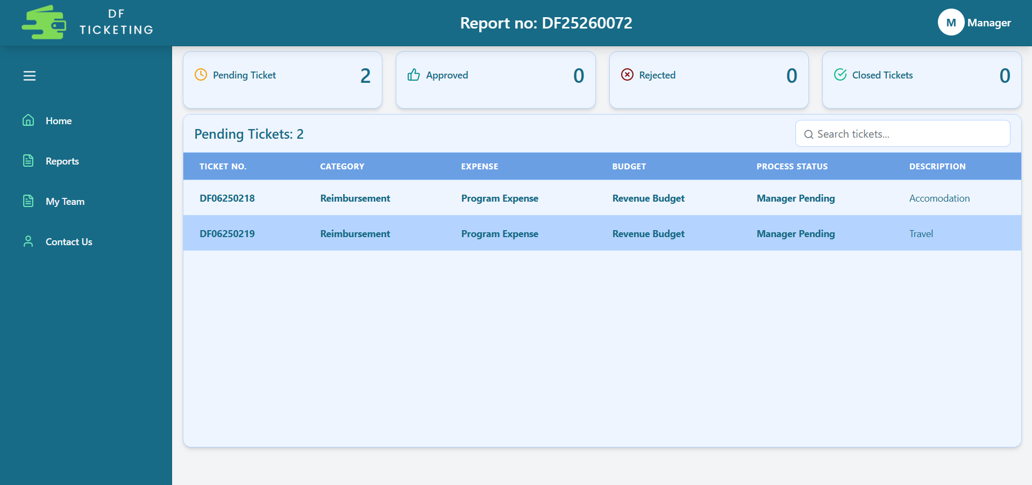
Inside My Team
Count of tickets status
List of tickets raised by a team member inside the report

Slide 17
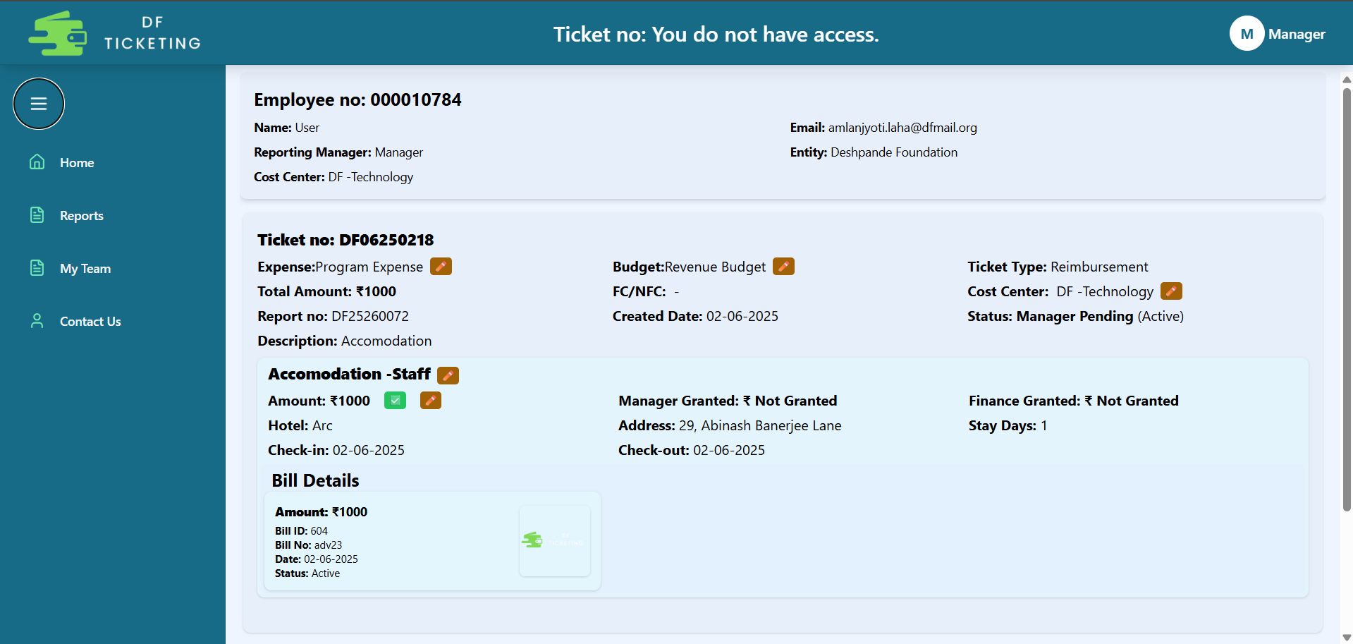
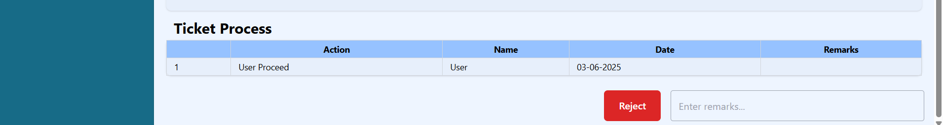
Inside Ticket
abc.xyz@dfmail.org

Slide 18
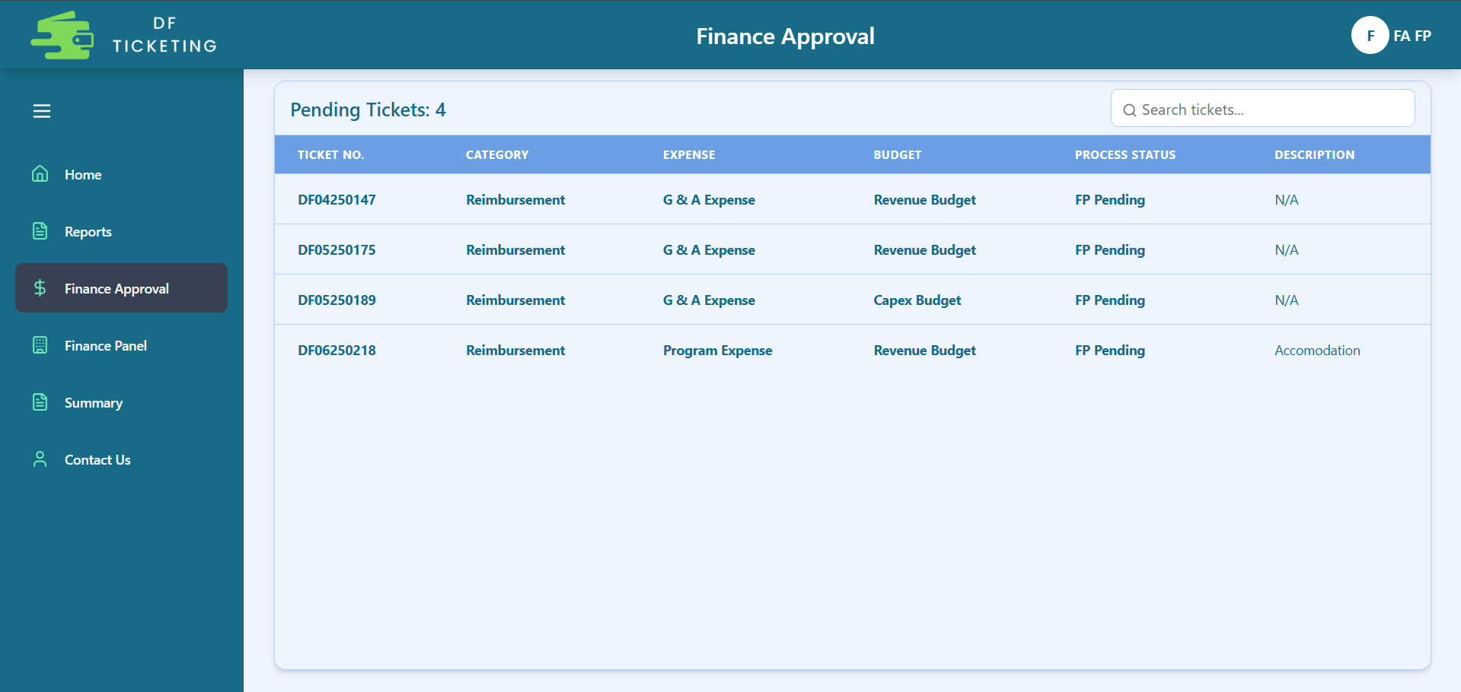
Finance Page
List of tickets pending Finance Approval.
FA and FP can view all tickets in the 'Finance Approval' tab that have been approved by managers and are awaiting Finance Approval.

Slide 19
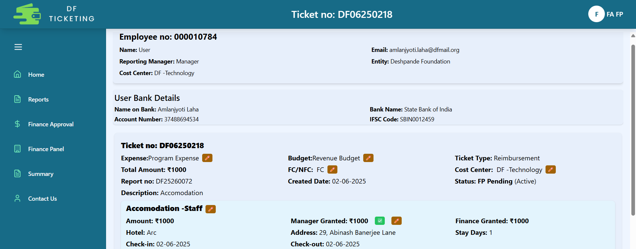
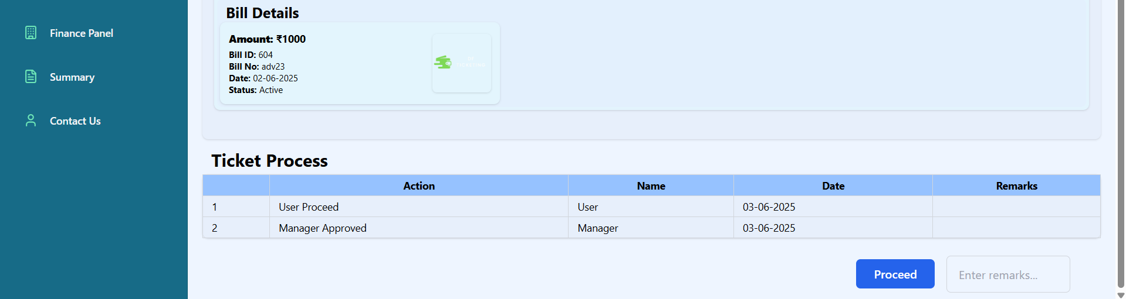
Finance Processer Page
abc.xyz@dfmail.org
User
12345678910
12345678910

Slide 20
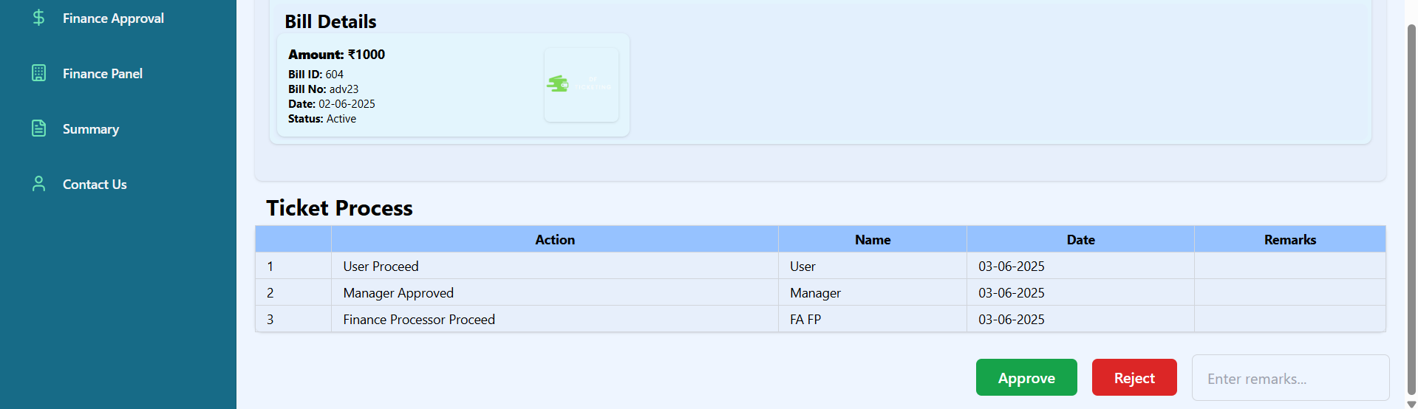
Finance Approver Page
abc.xyz@dfmail.org
User
12345678910
12345678910

Slide 21
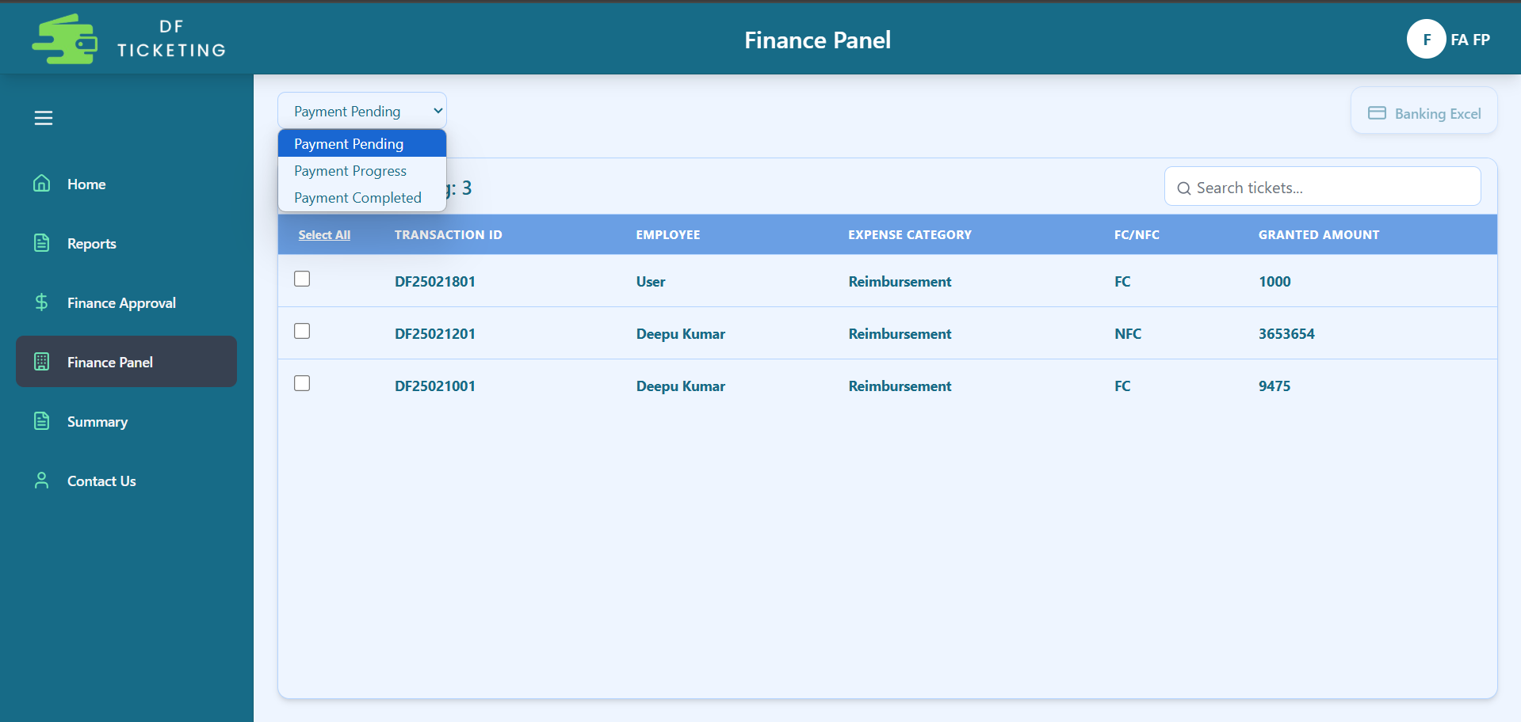
Finance Panel

Slide 22
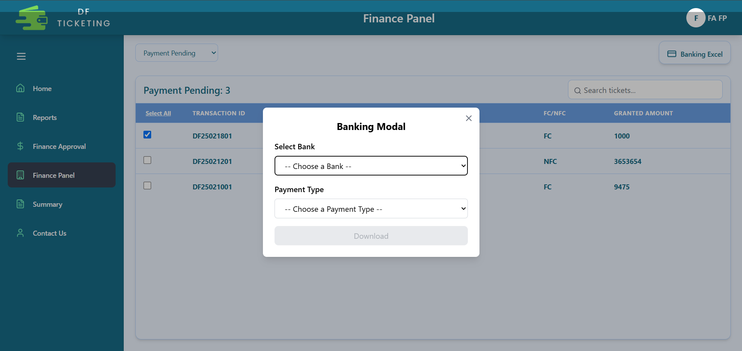
Payment
To process a payment in the Finance Panel, select 'Payment Pending' from the status dropdown at the top left. You will then see a list of tickets pending payment. Select the desired ticket and click the 'Bank Excel' button at the top right. Then, choose the bank and payment type to download the bank Excel file.

Slide 23
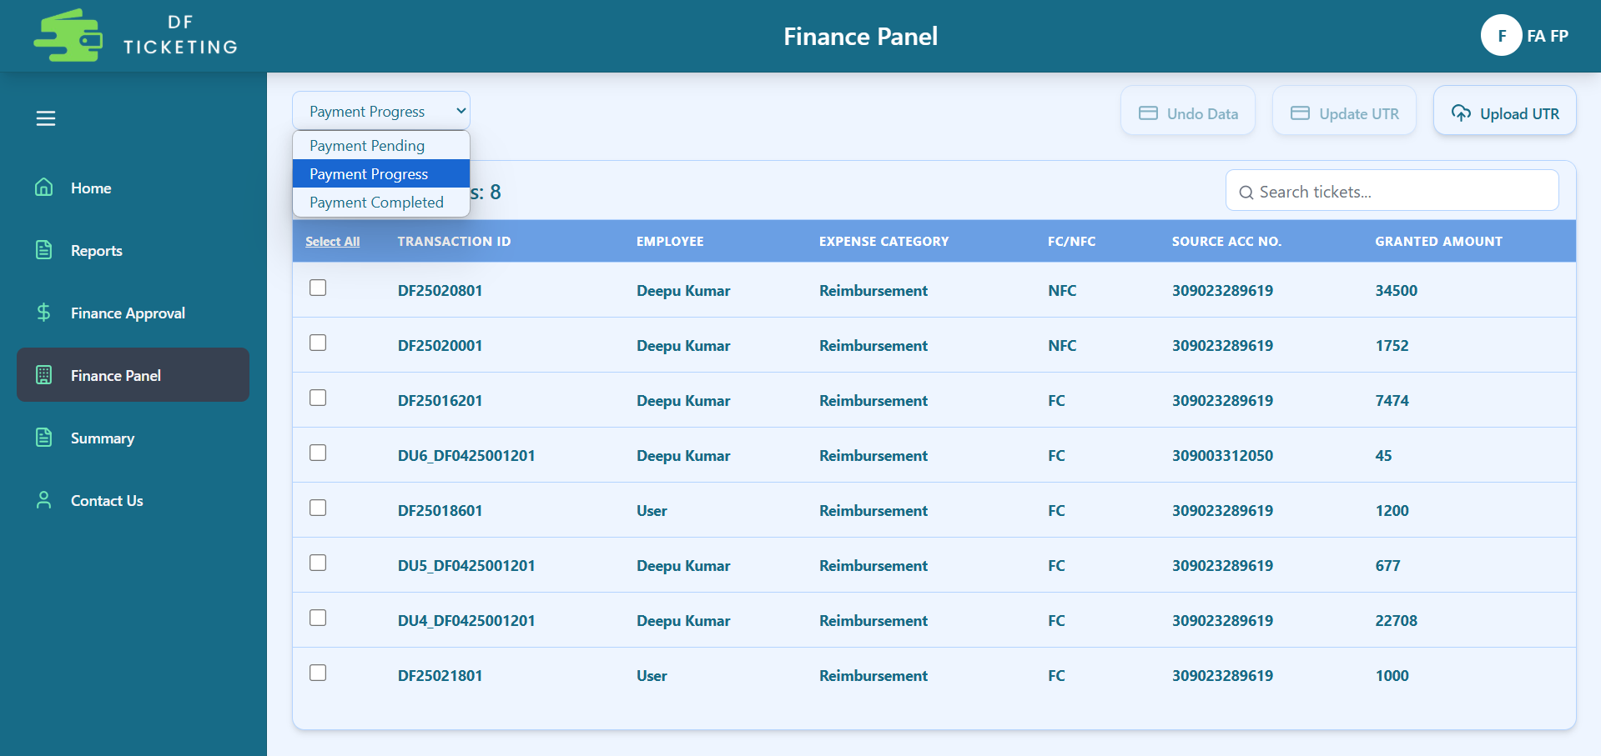
Payment
After that, the ticket will move to the 'Payment in Progress' section. Here, you need to select the ticket for which the payment has been made, then click on 'Update UTR' to download the UTR Excel file. Fill in the required details in the Excel sheet, then click 'Upload UTR' to upload the completed file. Once uploaded, the ticket will be marked as closed, indicating that the payment has been completed.
If you accidentally downloaded the Bank Excel for the wrong ticket, you can select that ticket and click 'Undo Data' to revert it to its previous state.

Slide 24
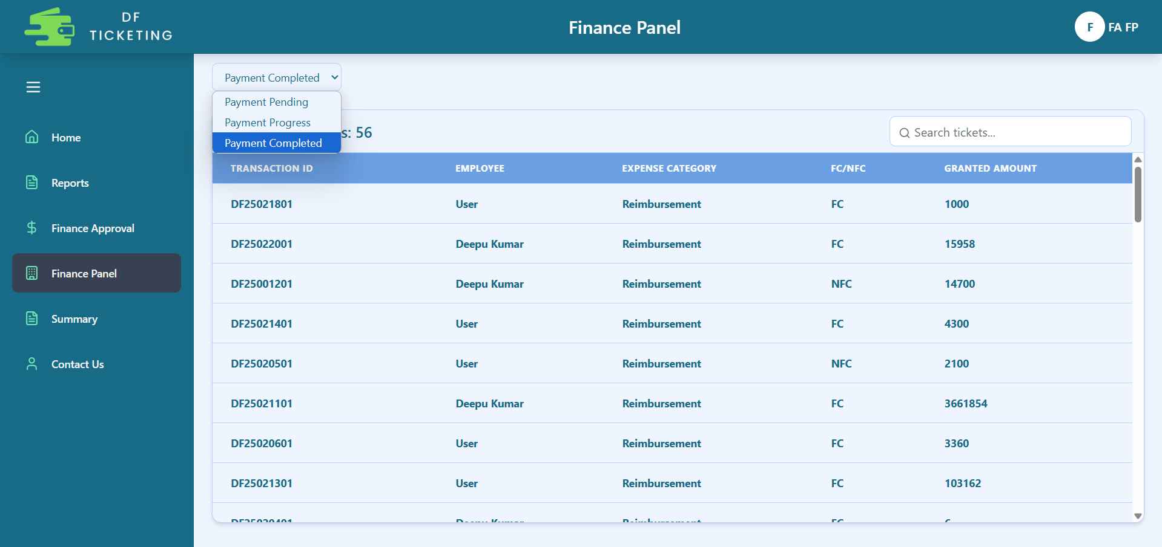
Payment
In this section you will see the list of completed payment tickets.

Slide 25
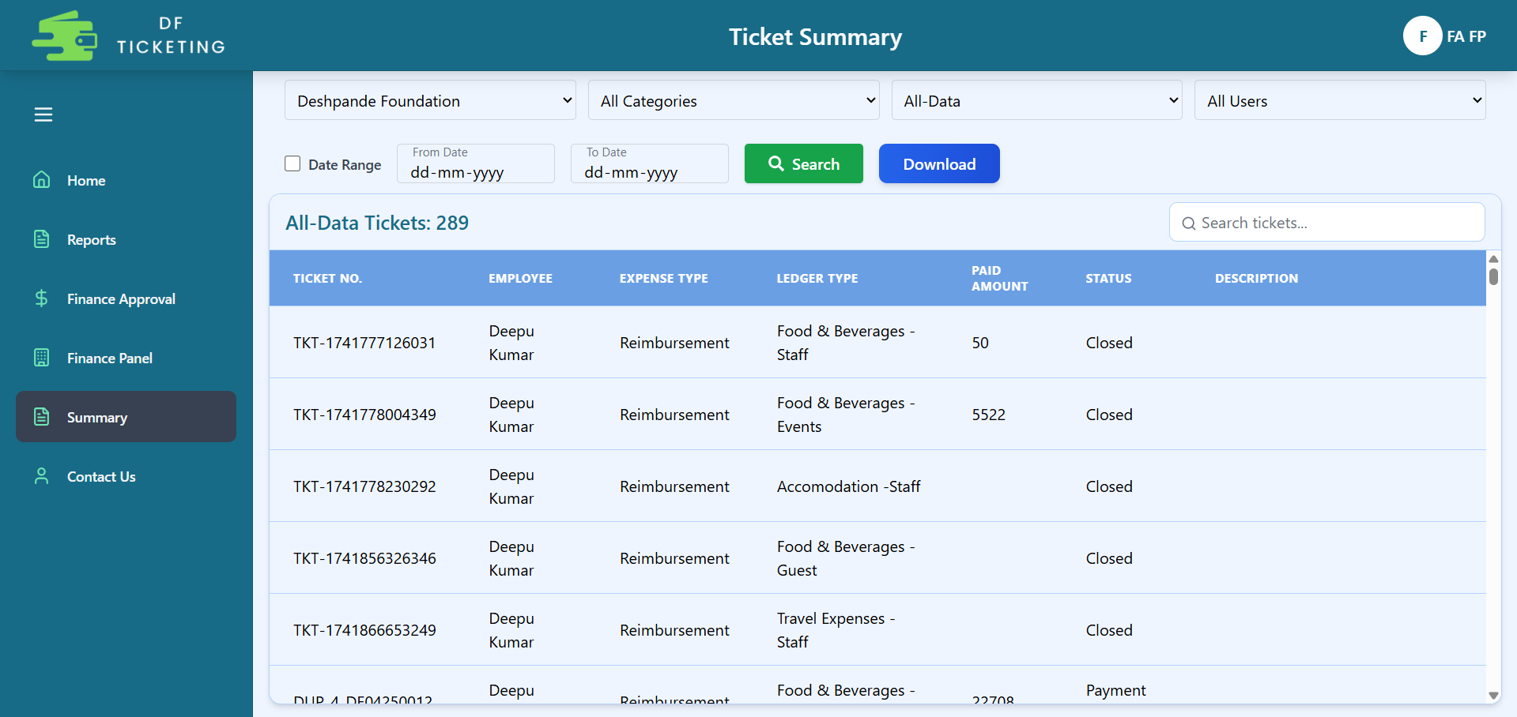
Summary
This section is for the Finance team to retrieve data based on Entity, Expense Type, Process Status, User, and Date Range, which can be downloaded for analysis.

Slide 26
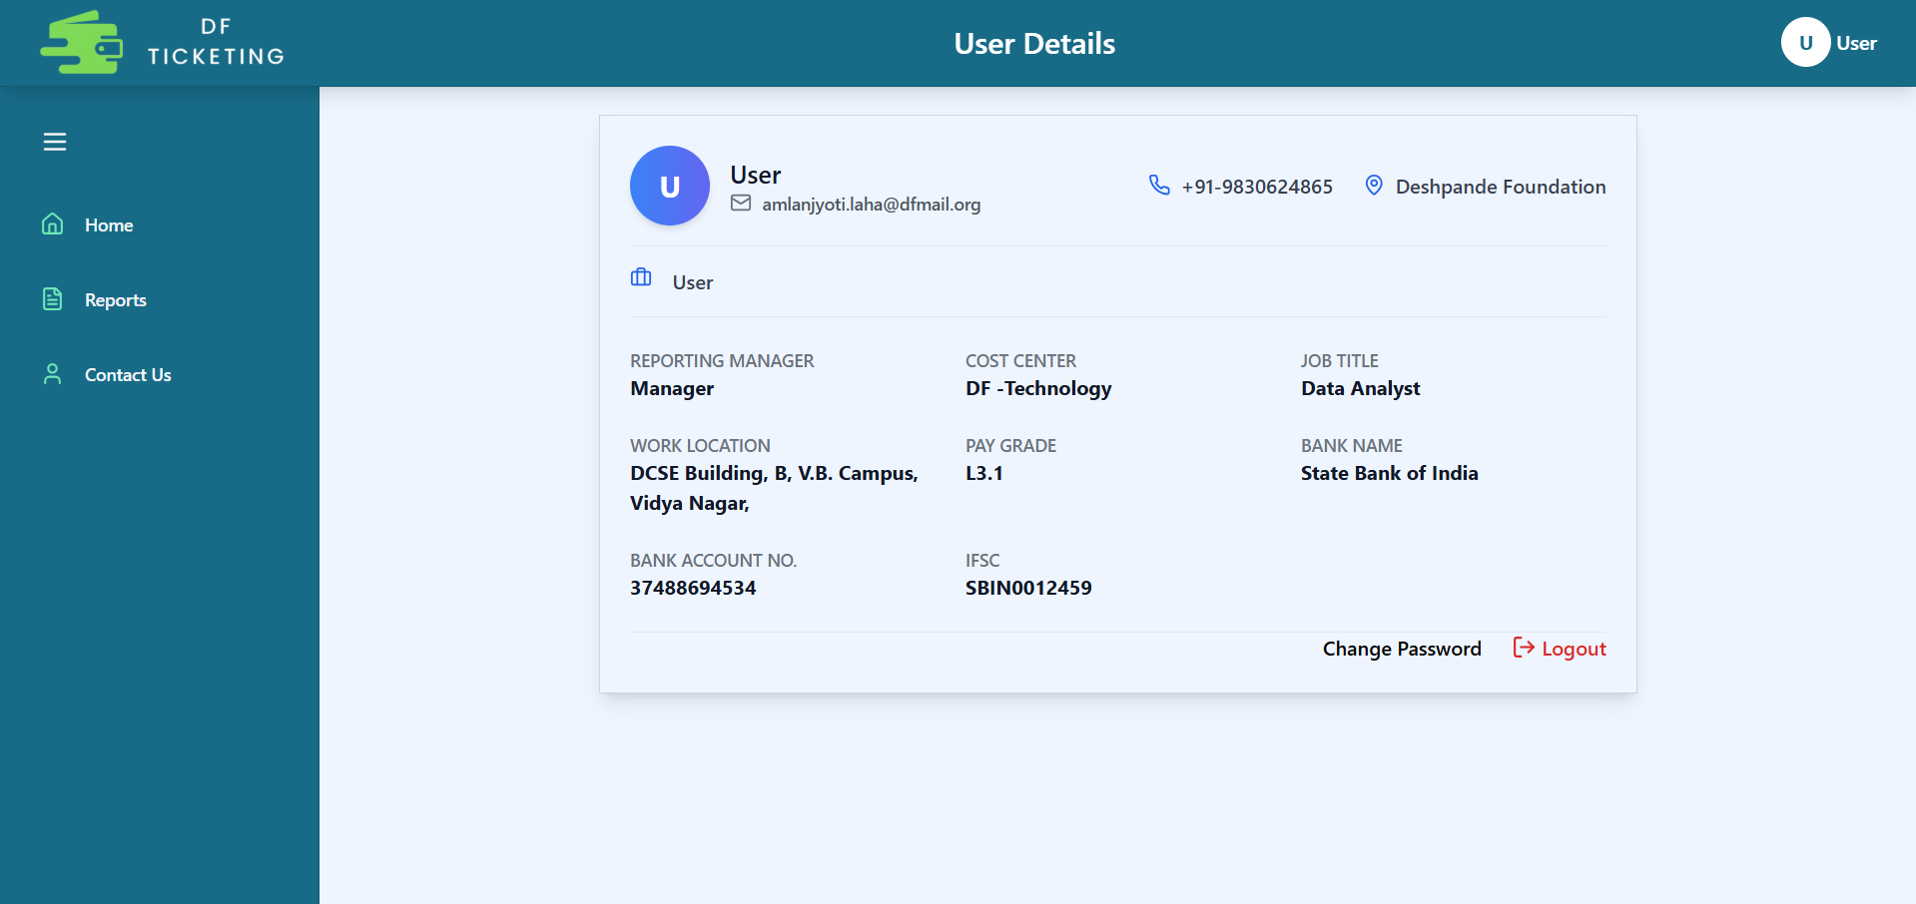
Profile Page
abc.xyz@dfmail.org
999999999
999999999
999999999

Slide 27
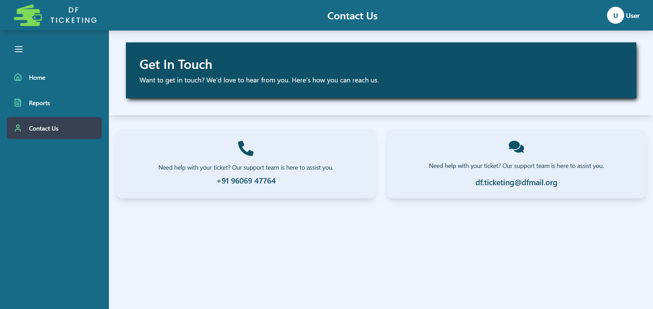
Contact Page

Slide 28
Thank You

